Slide 1
NeonRed

Slide 2
SRM Institute of Science and Technology,Vadapalani.
B.Tech in CSE, B.Tech in ECE
2nd Years
Kamlesh J V K
Vivek Bengani

Slide 3
Deal with NSE in Cliq!
Our App is for all the Share Market enthusiasts present out there, in this corporate world.
National Stock Exchange is one of the most populous stock market exchanges in the world. The white-collar workers who want to achieve a parallel source of passive income exploit this by keeping an eye out for a profitable deal even if its at the cost of neglecting work in office hours.
We come into the picture and help users to BUY, SELL, TRACK LIVE ORDERS, CANCEL ORDERS, and add to WATCHLISTS, the interesting stocks (available in the NSE market) based on our user’s interests & motives.

Slide 5
Audience and Businesses
Stock Traders (in general)
Intraday traders who have to quickly take action with respect to abrupt price movement
White-Collar Office workers who want to take a look at their portfolio or watchlist during recess breaks (Ethical Moonlighting)
Almost all market enthusiasts who want to keep up even in busy office hours!

Slide 6
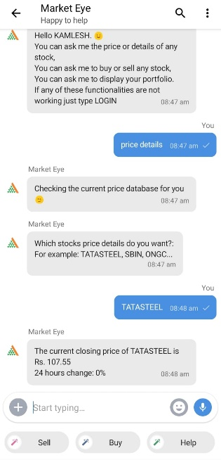
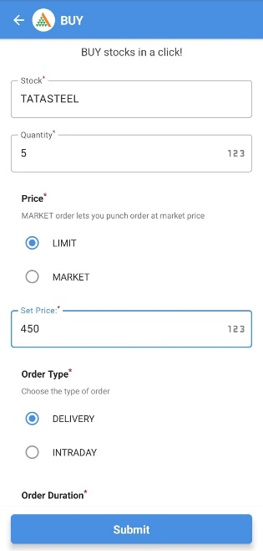
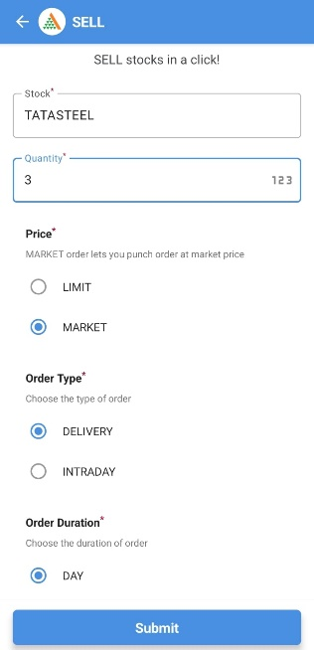
->Get live price of the desired stock ->Get live portfolio of the user ->Place order to buy stocks ->Place order to sell stocks ->Track the status of placed orders ->Maintain a watchlist of stocks -> Cancel Order

Slide 8
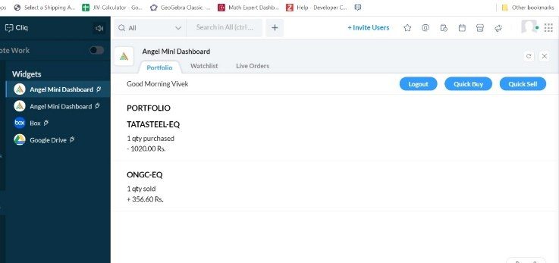
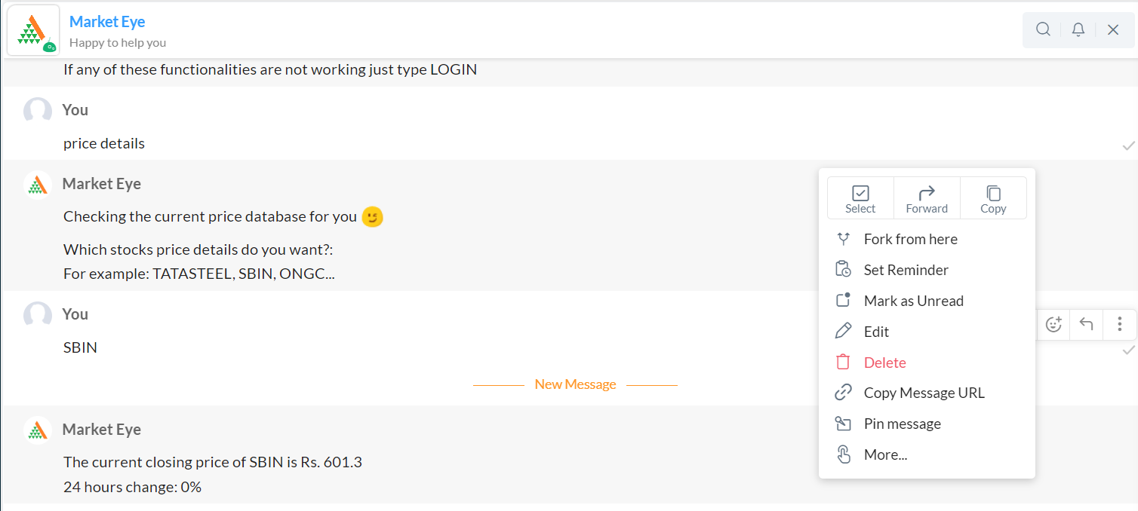
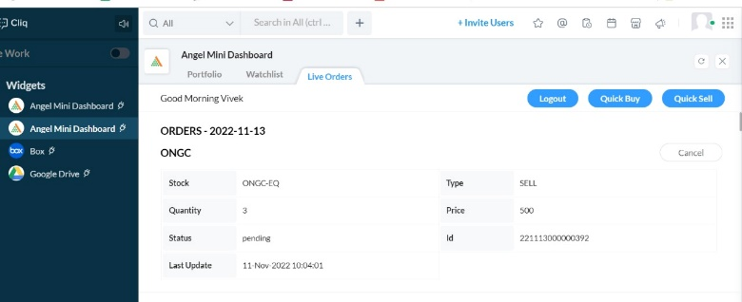
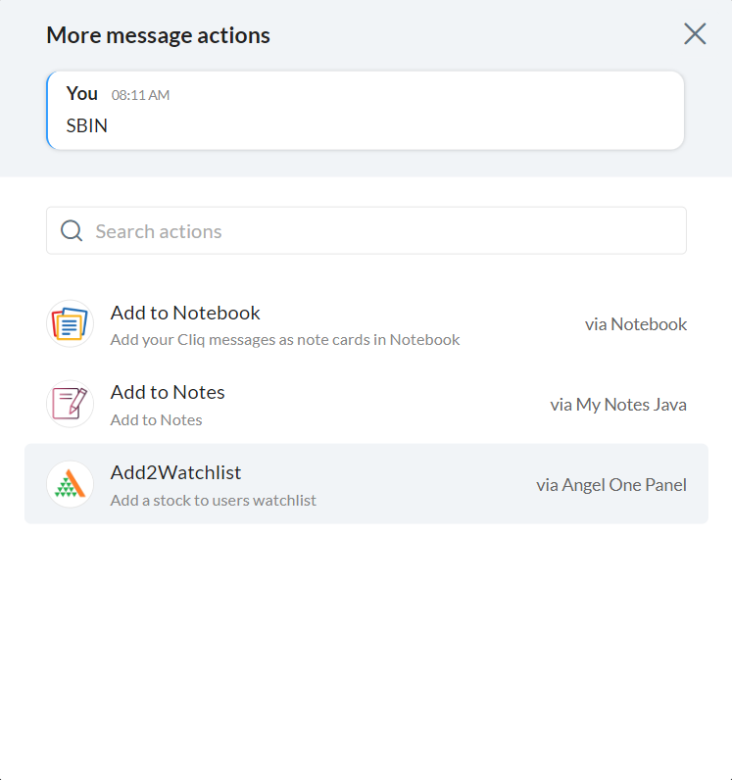
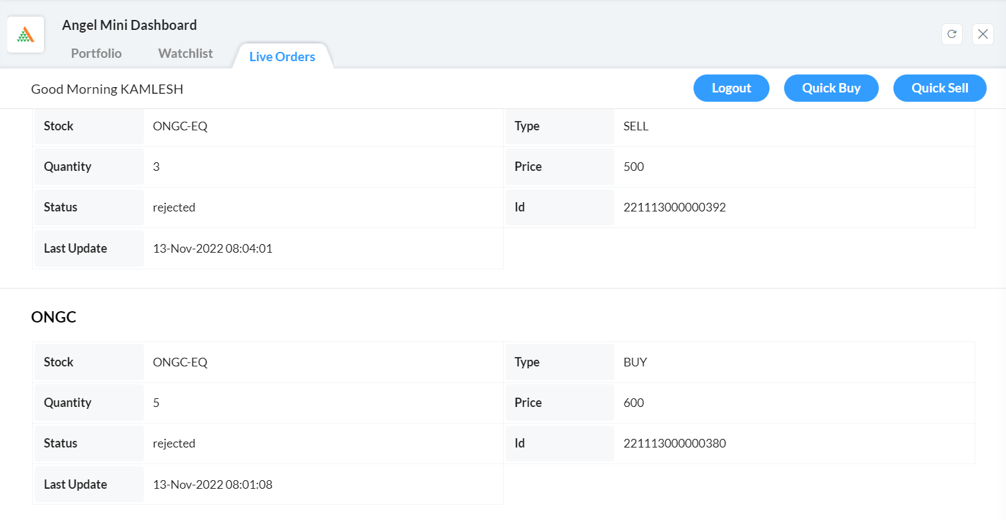
The Look

Slide 9
Widget-
Angel Mini Dashboard
Bot- Market Eye
Message Action-
Add2Watchlist
Function- appletFunction
Datastore-
Credentials & Watchlist
Cache-
lastLogin

Slide 10

1. Market Eye (Bot) Immediate help such as getting the live price of the stock. 2. Angel One Panel Detailed help such as getting placed order details. 3. Datastore help such as getting placed order details 4. Message action & Cache

Slide 12

AngleOne
Set of REST-like HTTP APIs that provide several required capabilities to build a complete stock market investment and trading platform.
References:
https://smartapi.angelbroking.com/docs

Slide 13
(App link: https://cliq.zoho.com/installapp.do?id=4514 )

Slide 14
Questions?

